Slide 1

SimplerCare App
Development of a Care Coordination Tool to Support Better Outcomes in Children with Complex Medical Care Needs
Transforming
Tools Together

Slide 2
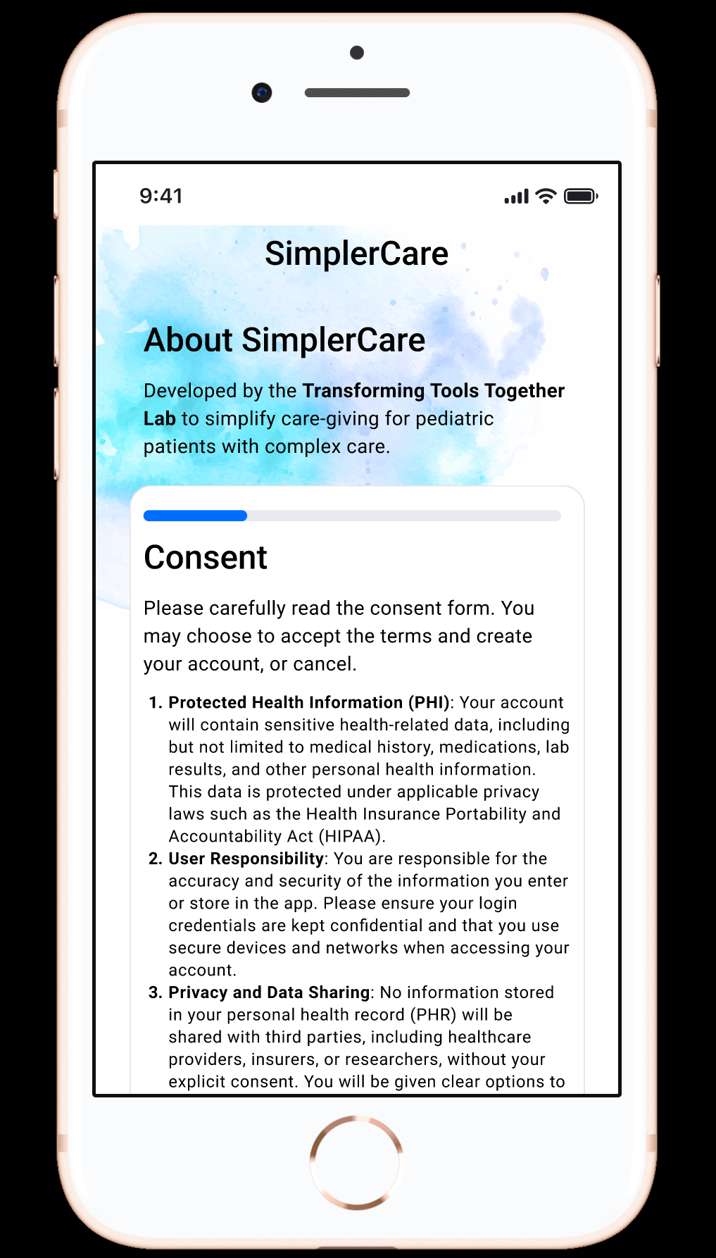
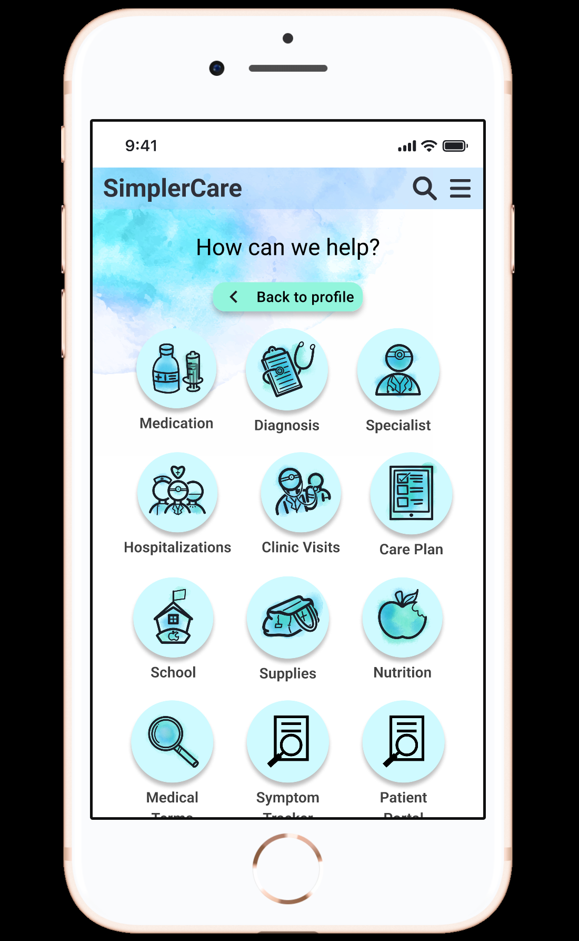
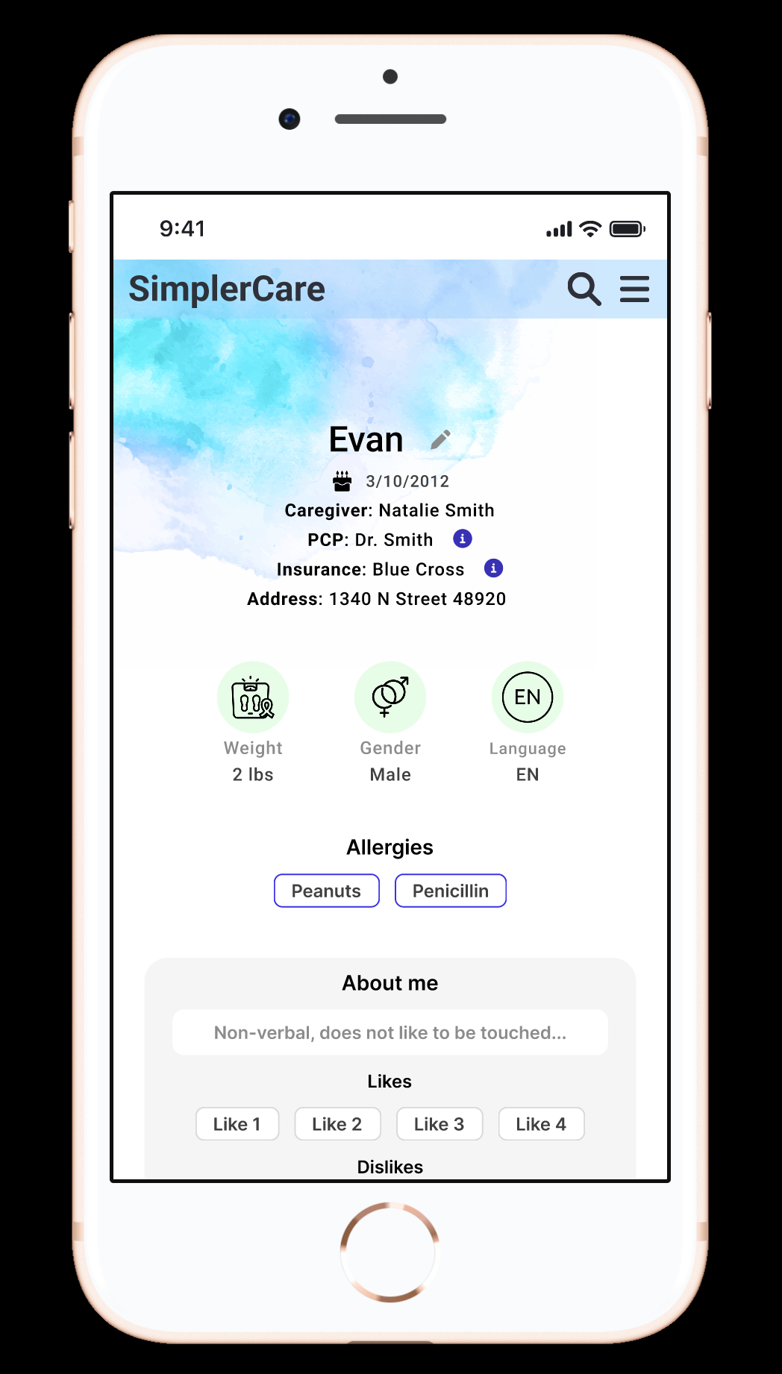

Slide 3
Hypothesis
A user-friendly, accessible care coordination tool tailored for families of children with CMC (complex medical care) in underserved areas will improve care integration, reduce caregiver burden, and enhance communication between families and healthcare providers.

Slide 4
Project Aims
1. Develop a prototype for a care coordination mobile application based on caregiver and provider input that is accessible, user-friendly, and adaptable to various healthcare settings.
2. Refine the tool based on feedback from caregivers, PCPs, and nurse coordinators to ensure it meets the needs of all stakeholders.
3. Evaluate the tool’s usability, content, and feasibility for integration with electronic medical records (EMRs).

Slide 5

Project Aims (continued)
4. Assess the impact of the tool on caregiver burden and provider workload and child outcomes as defined here:
Health and Clinical Outcomes
Reduction in hospitalizations and emergency department visits
Improved management of chronic conditions (e.g., asthma control, seizure frequency)
Medication adherence and accuracy
Timeliness of care (e.g., fewer delays in referrals or treatments)
Quality of Life and Functioning
Child’s physical and emotional well-being
Developmental progress
School attendance and participation
Family and Caregiver Outcomes
Caregiver burden and stress levels
Caregiver satisfaction with care coordination
Perceived support and empowerment
Time spent navigating care systems.
System-Level Outcomes
Care plan completeness and usage (e.g., shared plans of care)
Care team communication and collaboration.
Equity in service delivery

Slide 6
Individual Aims
leading stress-reduction applications (e.g., Calm, Headspace) to identify successful design patterns and content strategies applicable to the complex care context.
Develop the ethical gamification prototype: Design the gamification feature (meditative sand landscape, rock stacking, or Bonsai tree growth), ensuring the mechanics prioritize intrinsic motivation (expression, self-reflection) and mitigate ethical risks (manipulation, trivialization) identified in the secondary research.
Curate and validate affirmation content: Gather, and integrate positive affirmation statements and supportive messaging specifically tailored to the emotional needs and stressors of complex medical care caregivers.
Evaluate usability and emotional impact: Conduct targeted user testing to assess the usability and perceived psychological effectiveness of the gamification feature in reducing stress and improving feelings of validation/support

Slide 7
Broader Impact
Individual & Family Level:
Reduce Caregiver Burden and stress levels.
Improve Caregiver satisfaction, perceived support, and empowerment.
Enhance Child Quality of Life and functioning (physical and emotional well-being).
System & Clinical Level:
Improve Medication adherence and accuracy.
Enhance Care Team Communication and Collaboration to increase care plan completeness.
st important thing: the audience won’t miss the point of your presentation

Slide 8
Genre and Audience
Genre: Mobile Health Application and Care Coordination Tool.
Primary Audience:
Families/Caregivers of children with Complex Medical Care Needs (CMC),Secondary
Audience (Stakeholders):
Primary Care Providers (PCPs) and Nurse Coordinators.
Hospital Systems and Research Partners (MSU/Michigan Medicine).

Slide 9
Logline Statement
Simpler Care is a mobile care app that serves as a coordination tool to empower caregivers of pediatric patients with complex medical needs by integrating ethical gamification like meditivate rock stacking, bonsai tree growth, to provide psychological support and reduce the stress and burden on the caregiver through curated positive affirmations.

Slide 10
Secondary Research (ongoing)
Source: "Gamification in Apps and Technologies for Improving Mental Health and Well-Being: Systematic Review".
This paper provides important data on what gamification is currently being applied in the mental health space versus what elements should be applied in mental health tools.
Misaligned Implementation: Current application of gamification to mental health does not align with the critical trend observed in the general health and well-being literature that relies heavily on a "behaviorist approach... extrinsic motivators" (for example: just using points/badges).
Most Common Gamification Elements: The most commonly used gamification elements were levels or progress feedback (80%) and narrative or theme (48%), while badges or achievements (24%) and social cooperation (10%) were far from dominant.
Research Gap: Despite this varied application, research suggests that the use of gamification in mental health is not driven by health behavior change theory, and many researchers may treat gamification as a "black box" without considering its underlying psychological mechanisms.

Slide 11
Secondary Research
Source: A Gamification Model to Encourage Positive Healthcare Behaviours in Young People with Long Term Conditions"
This paper discusses the reasoning and framework for using gamification to address the critical issue of transitional care for adolescents.
The document systematically breaks down how various game dynamics serve as mechanisms to promote complex, specific self-care behaviors:
Feedback Dynamic (Appointments/Bonuses): This dynamic uses rewards to encourage crucial behaviors like regular contact with the clinical care team and ensuring adherence to treatment.
Progression Dynamic (Levels/Achievements): This provides motivation and demonstration that the young person is attaining "more advanced knowledge and skills as they mature," confirming satisfactory progress toward adult care transfer.
Digital Success: Previous research has shown that mHealth apps using gamification were successful in improving the daily average frequency of blood glucose measurements by 50% in adolescents with Type 1 Diabetes.

Slide 12
Secondary Research
Source: "Serious Games and Gamification in Healthcare: A Meta-Review".
This meta-review provides strong evidence regarding research gaps, ethical concerns, and future trends about gamification in healthcare.
The current research highlights limited research on the ethical and legal implications of serious games and gamification for health. A major challenge is ensuring informed consent and protecting patient privacy and sensitive information when these gamification interventions may potentially be used to manipulate user behavior.
This source also provides a concise summary of where gamification is currently focused in healthcare:
Serious games and gamification are used to address a wide range of conditions, primarily categorized into chronic conditions, mental health disorders, and physical rehabilitation.
The overall trend is shifting toward the use of mobile and digital platforms, Virtual Reality (VR), and Machine Learning to personalize and adapt interventions.

Slide 13
Persona

Slide 14
Production Goals
Conduct a Competitive Analysis: complete a competitive analysis with stress-reliever apps such as Calm and Headspace to identify successful design patterns and gamification strategies applicable to the complex care context.
Develop Visual Sketches: Create design options and multiple sketch options for the three gamification components—a bonsai tree rooted in sand, a sand landscape, and rock stacks.
Collect and Create Affirmation Content: create a list of positive and supporting messaging specifically tailored to the needs of complex medical care caregivers.
Develop a Gamification Prototype: Design and build the gamification feature with curated affirmations (meditative sand landscape, rock stacking, or Bonsai tree growth).
Conduct Usability and Accessibility Testing: Conduct targeted user testing to assess the usability and perceived psychological effectiveness of the gamification feature in reducing stress and the burden on the CMC caregiver.

Slide 15
Competitive Analysis

Slide 16

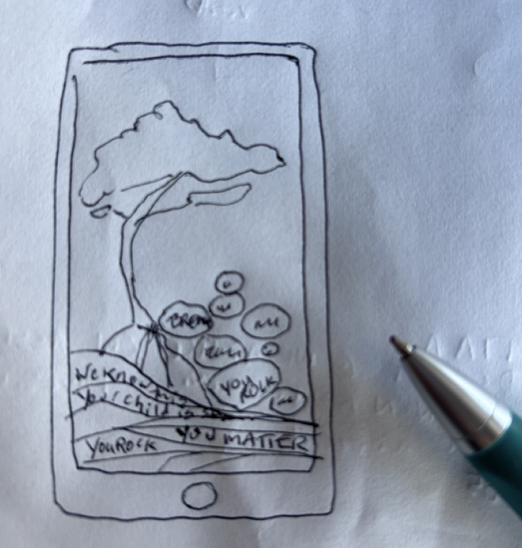
Affirmation Lines (For the Gamification Screens)
Prototypes for gamification including 3 options - A bonsai, sand layers and rock stacks that all have affirmative phrases on them. The phrases include things like:
I Matter.
I got this.
I am doing an amazing job.
I really do know best.
I am the key to your child’s success.
I am rocking this.
This is hard.
You are worthy.
Your relationship with your child is beautiful.
One step at a time.
Trust your intuition.
Take a breather.
Take a moment.
You care so much.
You are strong.
MY gut is not wrong.
I will get through this and anything else in my path.
I am not alone.
As a parent of a special needs child, my journey is different.
I know my child best.
My child is strong.

Slide 17
Affirmation Lines (For the Gamification Screens)
Things will get better.
I can take time for myself.
I am growing.
Start where you are, use what you have, do what you can.
Thank you for supporting your child.
It is okay to acknowledge this situation sucks.
Little by little, a little becomes a lot.
I am going going to be okay.
It is okay to be angry.
I have all I need to become the best version of myself.
My courage is inspiring.
I am brave.
My feelings are real and I can work with them.
I am resilient; I’ve overcome things before.
It's okay to ask for help.

Slide 18
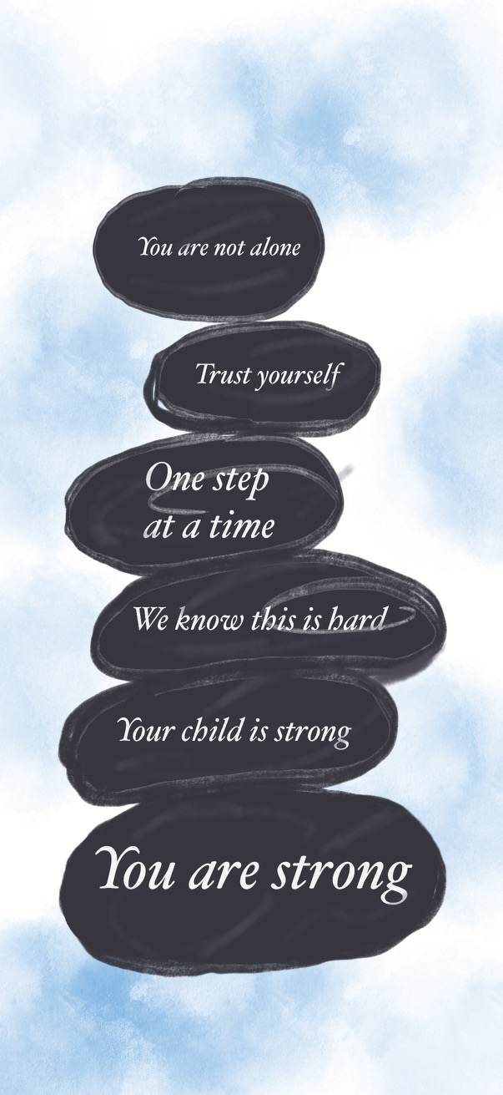
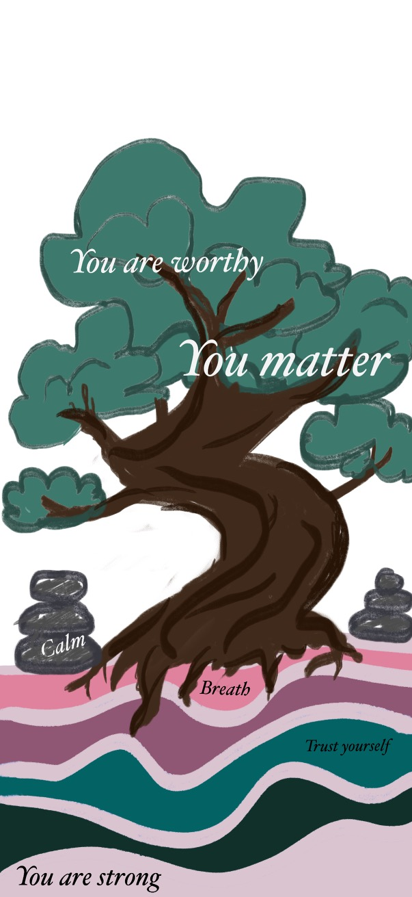

Initial Sketches

Slide 19
Color Scheme
Key Soothing Colors
Blue: Widely considered beneficial to the mind and body as it slows human metabolism and produces a calming effect. Blue is strongly associated with tranquility and calmness. In a medical environment, seeing the color blue can cause the body to produce calming chemicals(Cerrato, 2012).
Green: Green is very restful for human eyes. The color can have great healing power and symbolizes harmony between the body and the mind. Physiologically, green balances people's emotions, creating a sense of calm. Hospitals utilize light green rooms because they too are found to be calming to patients (Cerrato, 2012).
Turquoise: Physiologically, turquoise can calm emotions and restore depleted energy levels and boost positive thought (Cerrato, 2012).
White: White is calming as it creates simplicity, organization, and efficiency(Cerrato, 2012). It is associated with cleanliness and sterility (Cerrato, 2012).
Pink: Is one of the most calming colors. Pink is also reassuring, and boosts emotional energies which can decrease the feeling of anger. (Cerrato, 2012).

Slide 20
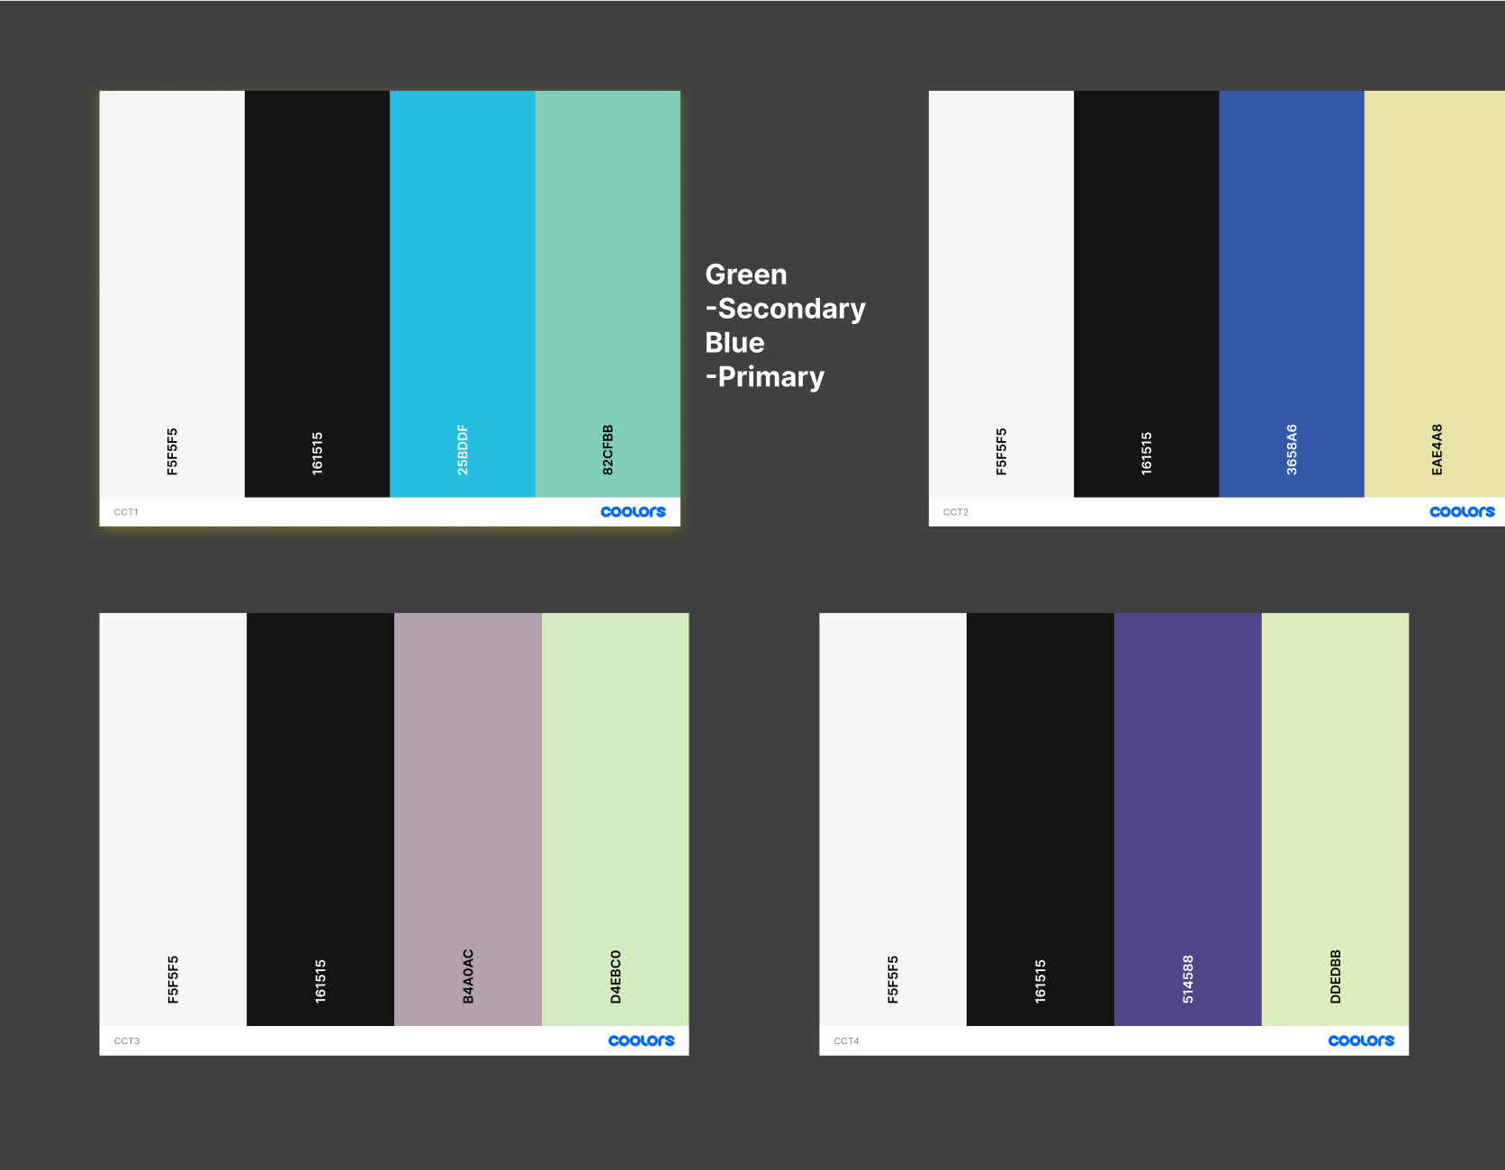
Color Scheme

Slide 21
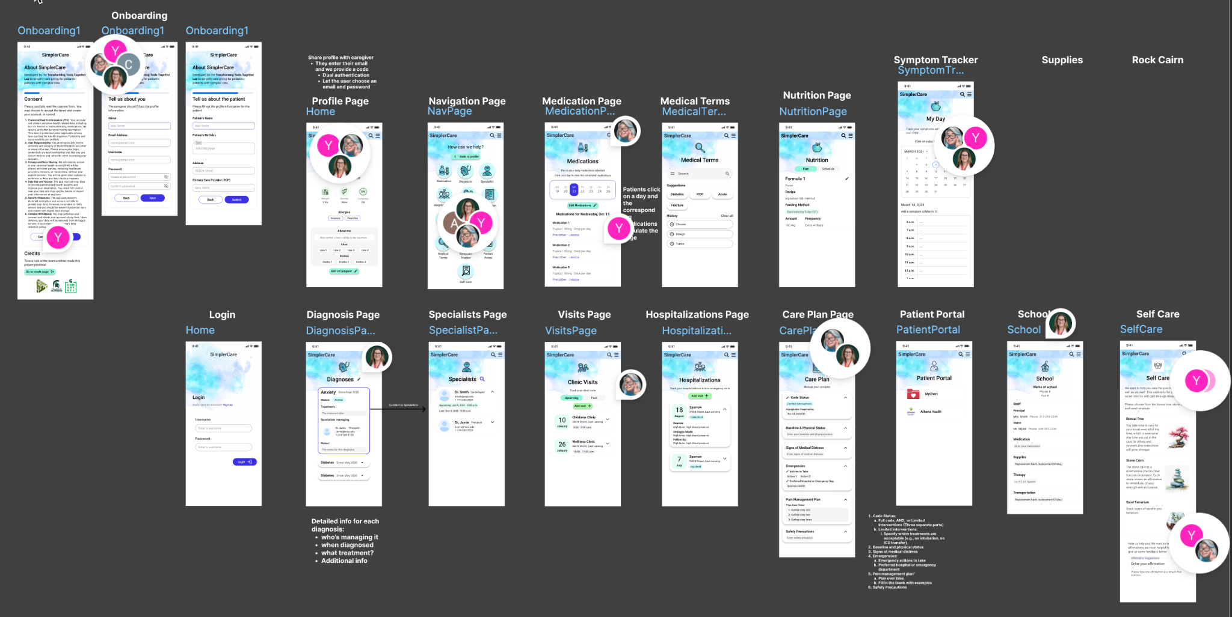
Prototype: Figma Prototype

Slide 22
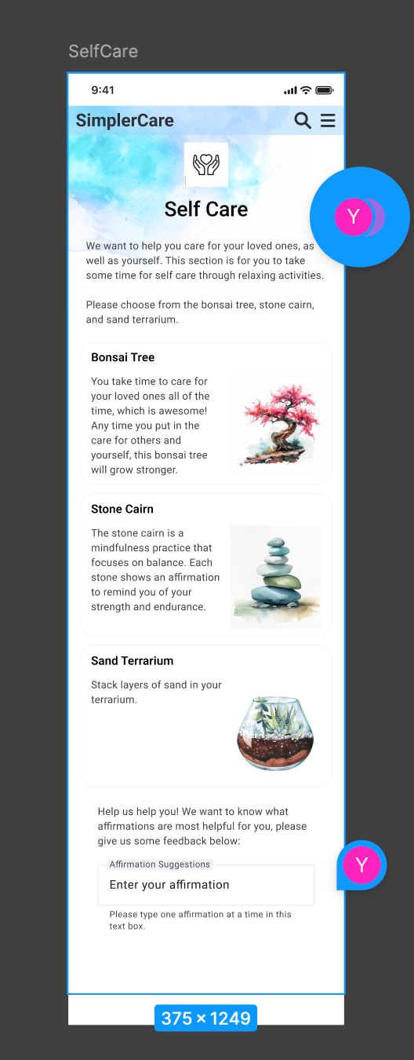
Gamification Prototype

Slide 23
User Insights and Findings
I conducted this user test to evaluate the usability and user experience of the SimplerCare App. The design challenge for this app is to create a tool that simplifies the complex medical needs management for the guardians and caregivers of pediatric patients with complex care needs. The tool will also include a gamification piece that reduces the stress and burden for the caregiver. This phase of testing was to focus on the navigation flow of the app and the potential stress relieving values of the self care features (gamification screens, art visuals, and affirmations)

Slide 24
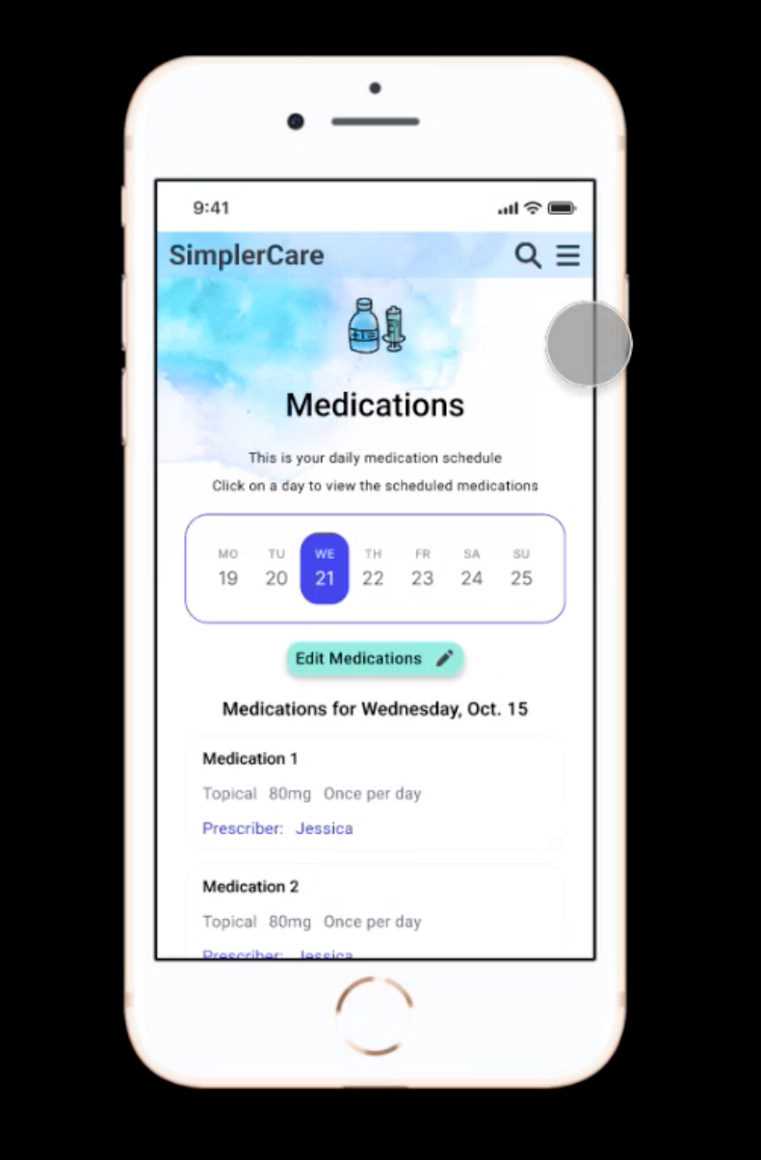
User Insights and Findings
For this phase of testing, I engaged one participant, who is a key stakeholder for this project and has an in-depth understanding of complex medical care situations, the target audience, and the app’s overall goal. Utilizing this participant gave me the opportunity to gather very helpful qualitative feedback about the design of the app and the foundation of the idea, before testing it with primary caregivers.

Slide 25

Diagram and Description of the Observation Location
The observation took place remotely via a video conferencing tool, Microsoft Teams
I the interviewer/moderator: Facilitated the session, provided prompts, and managed the flow.
Participant: Interacted with the Figma prototype link shared on-screen and employed the Think Aloud Protocol.
I documented the interaction, noting verbal feedback, Usability Cues and Emotional Cues with the observation form.The testing location allowed for screen sharing and audio recording, capturing the participant's direct interaction with the prototype.

Slide 26
Verbal Description of Participant
The current sample consists of a single participant, Dr. Cheri Salazar, who is a primary project stakeholder. Her feedback is deeply informed by research into the target population which is caregivers of children with complex medical needs. She stressed that these caregivers are often "not tech savvy and two, they're stressed" ¹⁰, emphasizing the critical need for the app to be "super simple" and to "actually simplify" their lives rather than add complexity. Her focus was primarily on ensuring the design achieves its core purpose of stability, intuitiveness, and stress reduction.

Slide 27
Usability Testing
User Observation Form
Key: | Yes/Occured | No Didn't Occur
Non-Verbal Behaviors |  |  | Observations & Emotions
Participant | 1 |  | Participant | 1
Smiling/Laughing/Happy |  |  | Engaged
Frowning/Grimacing/Unhappy |  |  | Intrigued
Concentration |  |  | Excited
Surprised/Unexpected |  |  | Quiet
Evidence of Impatience |  |  | Confused
 |  |  | Amused
 |  |  | Frustrated

Slide 28
Findings: Usability and Navigation Flow
Observation Category | Occurred (Yes/No) | Participant Feedback (Quote) | Recommendation
Clear Path Forward/Next Step | No | "There's no go forward... Like there's no next on this page, so is there a drop down or something that tells them where to go next?" | The design requires a clear, persistent call-to-action or navigational element.
Navigation Friction (Hamburger Dependency) | Yes | "The biggest one was the being making it a little bit easier to flow between without having to go up to the hamburger each time." | Relying on the hamburger/main menu for every return trip causes cognitive load and frustration.
Suggested Navigation Fix | Yes | "Maybe we can do like return to home... and that'll take them right back to this page." | A dedicated button/tap target is needed for fast return to the main dashboard.
Feature Accessibility/Prototype Status | Yes | "Supplies button doesn't open. And self-care is not opening right now either." | Broken links interrupt the flow and cause frustration, confirming the need to prioritize linking key user flows.
Multi-Patient Complexity | Yes | "When we if we have more than one child... do they have to go completely back to the first page?" | Need a simple, easily accessible toggle within the profile view, not a full re-onboarding process.

Slide 29
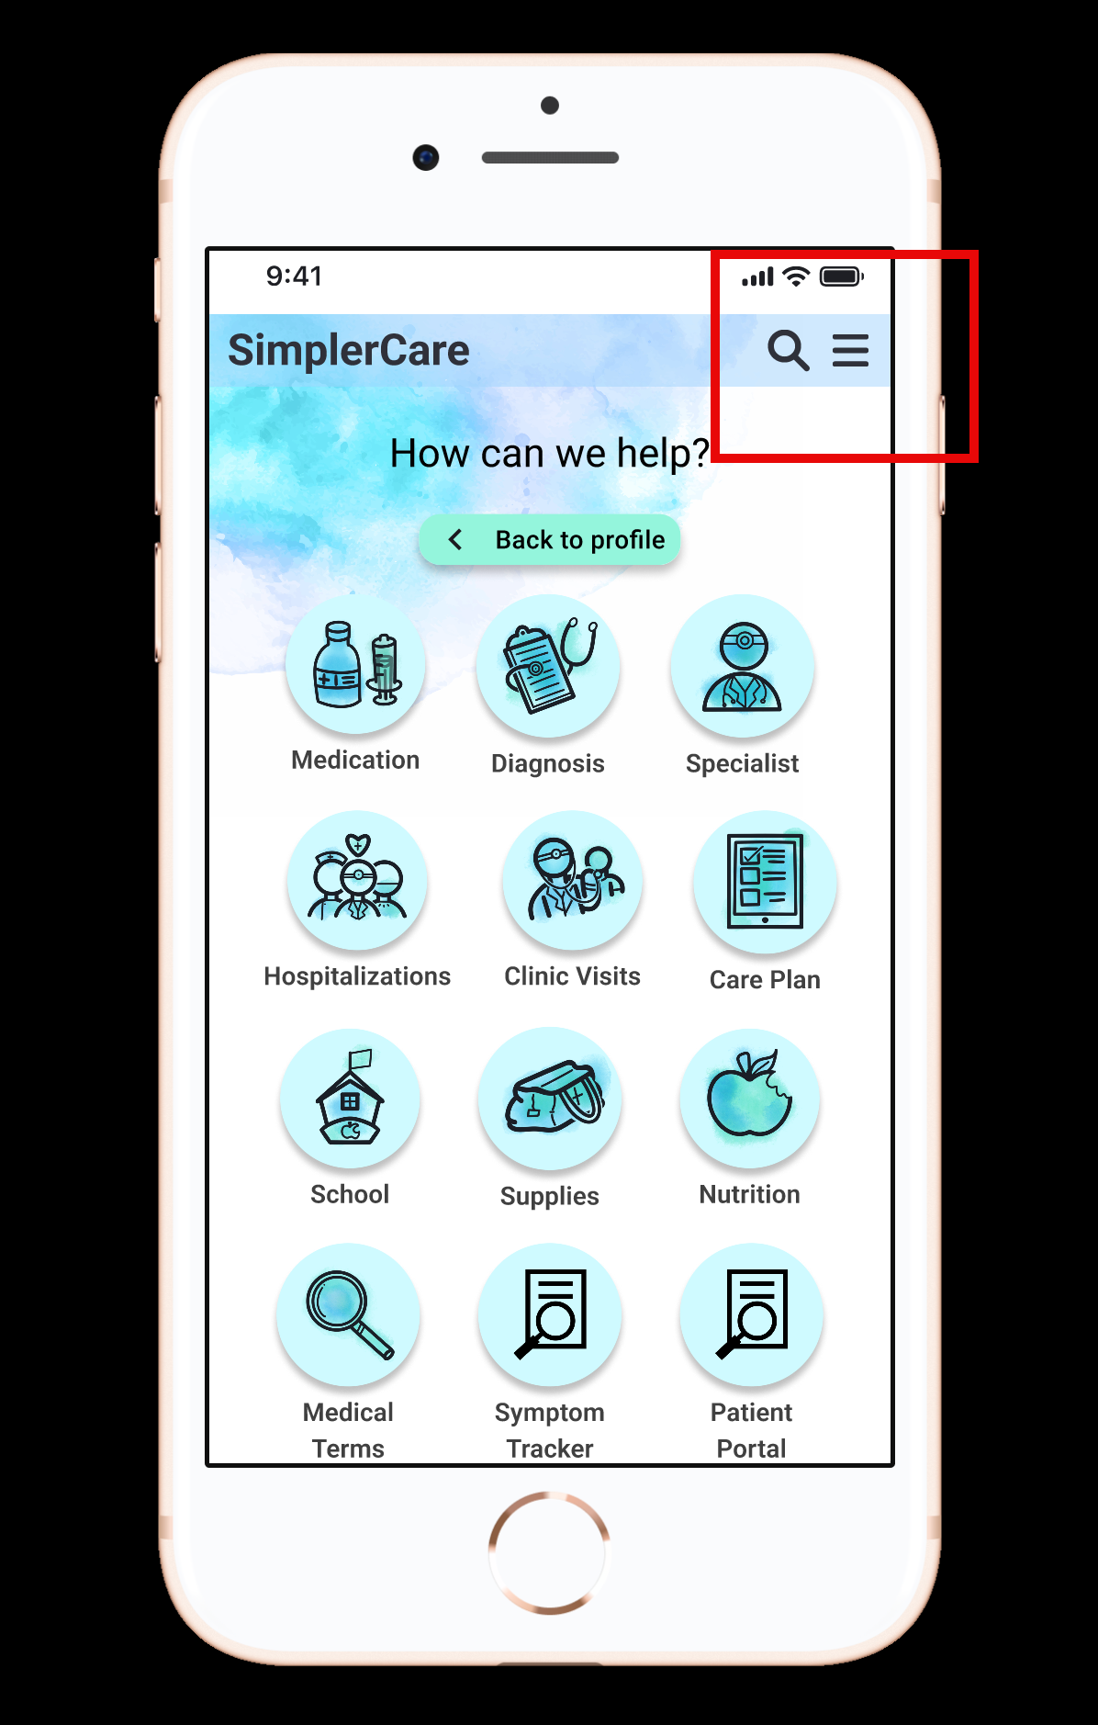
Findings: Usability and Navigation Flow Synthesized
The overall navigational structure of the app is function but the return flow is inefficient, relying on the confusing hamburger menu for every trip navigating back to the main page of the app.
Details: The participant immediately identified the lack of clear next steps upon completing or viewing a detailed page like the patient symptom tracker. She correctly identified the problem: needing to constantly exit back to the main navigation menu is cumbersome, especially for a user under stress.
Insights: Efficiency is crucial for stressed caregivers. The current system creates more effort. This points to a need for an i "Back to Home" or "Dashboard" button on every sub-screen to instantly reduce friction and cognitive load. The multi-patient flow must also be simple and intuitive.

Slide 30
Findings Content and Emotional Efficacy (Affirmations)
Observation Category | Occurred (Yes/No) | Participant Feedback (Quote) | Implication
Color Scheme/Aesthetic | Yes | "I really like what we chose. That whole watercolor. Like watercolor is very soothing and it has blurred edges and it's just there's nothing stark about it." | The soft, non-stark aesthetic successfully promotes calm and stability, aligning with the emotional goal.
Personal Efficacy of Affirmations | Yes | "I think if we just change it to I's to make it more personally affirmation." | Affirmations must be rewritten in the first person to be effective and resonate with the user's internal dialogue.
Group vs. Statement Language | Yes | "Instead of it saying we believe like who's we, right?" | Language that implies external authority or group belief ("we," "you have all you need") must be removed or rephrased to focus on the user's agency ("I am resilient").
Positive Value (Self-Care) | Yes | "Something for the parent or caregiver that everything else is always about their child." | The self-care feature is highly valued because it acknowledges and addresses the caregiver's needs, not just the patient's.

Slide 31
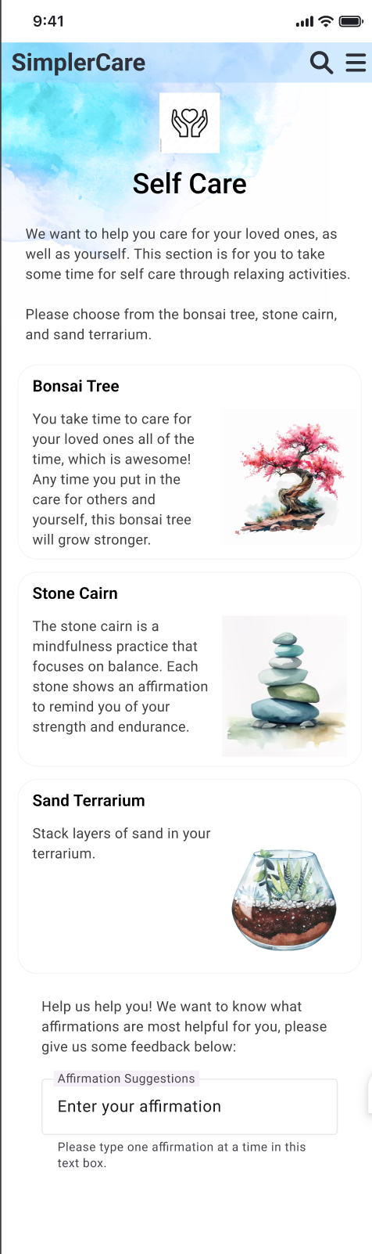
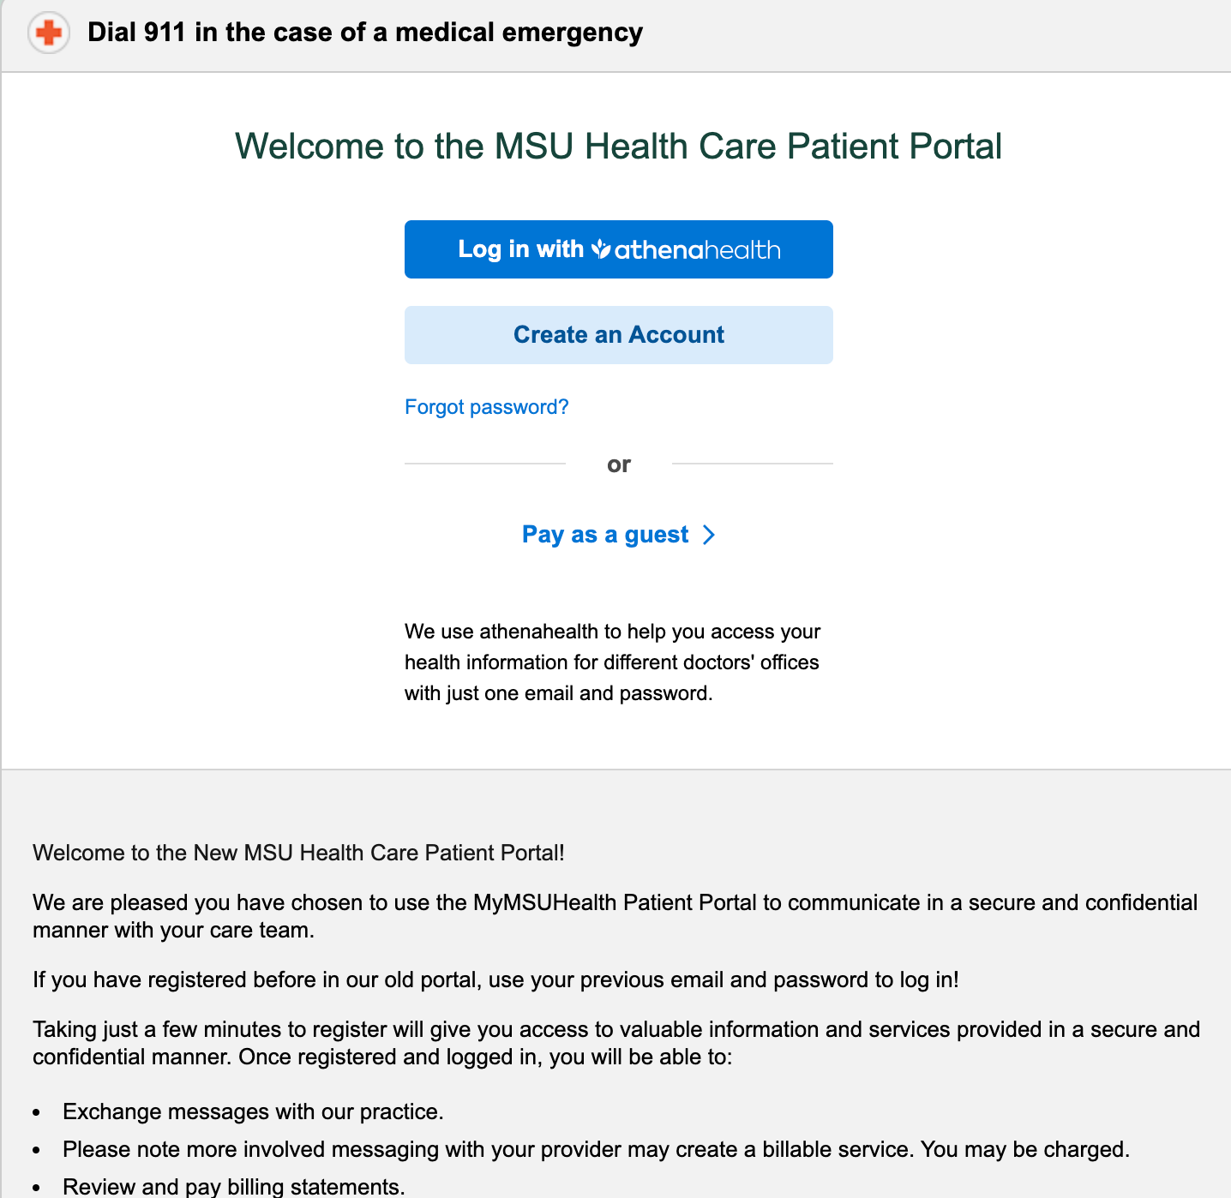
Findings Content and Emotional Efficacy (Affirmations) Synthesized
Overview: The visual design (watercolor scheme) successfully achieves its emotional goal of calmness. However, the language of the affirmations needs refinement to shift from external statements to active, first-person internal validation.
Details: The participant's feedback confirms the visual design choice was correct, offering a stark contrast to the "stark" nature of doctors offices and hospitals. The most critical finding in this section is the language mismatch in the affirmations. To truly help stressed parents, the messages should feel like they are coming from within for example: "This is hard," "I am resilient." Instead of something like “we believe in you.” Who is “we” in this situation.
Insights: An affirmation's power lies in the user's internal acceptance. The design must minimize external authority and maximize the sense of personal agency. The affirmations must be changed to highlight the caregiver's need for validation and stress relief separate from their role as a patient manager.
VVS

Slide 32
Overall Recommendations
Based on user feedback, our design must prioritize efficiency and personal emotional support:
Prioritize Core Navigation Efficiency.
Refine Affirmation Language for maximum psychological efficacy.
Complete Feature Linking to enable comprehensive testing.

Slide 33
Overall Recommendations - Navigation and Usability
Recommendation | Rationale
Implement Persistent "Back to Home" Button. Add a clear "Home" or "Dashboard" button/anchor on every sub-screen for one-tap return. | Eliminates reliance on the hidden Hamburger menu, reducing user friction and stress.
Add Seamless Multi-Patient Toggling. Integrate a simplified, persistent mechanism on the main profile screen to toggle between multiple patients. | Simplifies management for caregivers of multiple children; avoids tedious re-entry or navigation.
Fix Broken Links (Symptom, Supplies, Self-Care). Ensure all key features are linked and functional for the next testing phase. | Prevents user frustration and allows for full feature assessment in subsequent rounds.

Slide 34
Overall Recommendations - Content and Visuals
Recommendation | Rationale
Convert Affirmations to First-Person ("I") Language. Rewrite statements from "we" or "you" to "I" statements (e.g., "I have all I need"). | Increases personal relevance and psychological efficacy by aligning content with the user’s internal dialogue.
Consult Domain Expert (Dr. Sagal) on Content. Finalize the affirmation list and language based on clinical and contextual appropriateness. | Ensures the therapeutic content is validated and suitable for the target population.

Slide 35
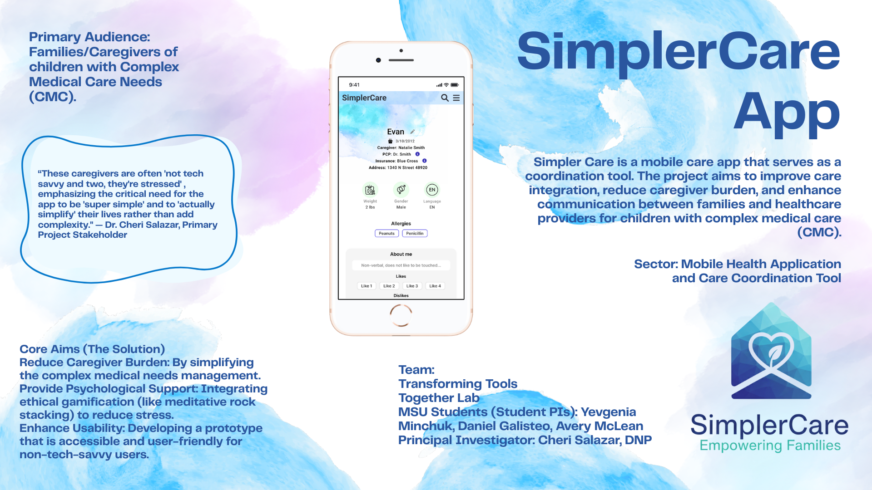

Slide 36
Design Researcher
“Aha!” Moments
USER
“Aha!” Moments
I realized that the language of the affirmations needed refinement to maximize psychological efficacy. The self-care feature is highly valued because it acknowledges and addresses the caregiver's needs, not just the patient's
- Avery McLean
“These caregivers are often 'not tech savvy and two, they're stressed' , emphasizing the critical need for the app to be 'super simple' and to 'actually simplify' their lives rather than add complexity." — Dr. Cheri Salazar, Primary Project Stakeholder

Slide 37

Our Partners

Slide 38
Our Team
Principal Investigator: Cheri Salazar, DNP, CPNP-PC/AC, CHPPN
Academic Position/Title: Assistant Professor, Michigan State University College of Nursing, Pediatric Nurse Practitioner, Michigan State Pediatrics
Co-Pis Faculty: Susan Bonner, Celeste Campos-Castillo
Project Site(s): Michigan State University Pediatrics, University of Michigan Pediatrics
MSU Students:
Student PIs: Yevgenia Minchuk, Daniel Galisteo, Avery McLean
Transforming
Tools Together

Slide 39
References
Cheng, V. W. S., Davenport, T., Johnson, D., Vella, K., & Hickie, I. B. (2019). Gamification in apps and technologies for improving mental health and well-being: Systematic review. JMIR Mental Health, 6(6), e13717. https://doi.org/10.2196/13717
Cerrato, H. (2012). The meaning of colors. The graphic designer.
Damaševičius, R., Maskeliūnas, R., & Blažauskas, T., T. (2023). Serious games and gamification in healthcare: A meta-review. Information, 14(2), 105. https://doi.org/10.3390/info14020105https://doi.org/10.1186/s12904-023-01166-9
Gupta, R. (2021). Color therapy in mental health and well being. International journal of all research education and scientific methods (IJARESM), 9(2), 1068-76.
Wilson, A. S., & McDonagh, J. E. (2014). A gamification model to encourage positive healthcare behaviours in young people with long term conditions. EAI Endorsed Transactions on Serious Games, 1(2), Article e3. https://doi.org/10.4108/sg.1.2.e3

Slide 40
Thank you!
Please keep this slide for attribution.

